Slide 1
Project Title
Indian Weather Forecasting & Data Analysis
Prepared By: Avadhoot Anil Jadhav.
Date: 11/12/2025

Slide 2
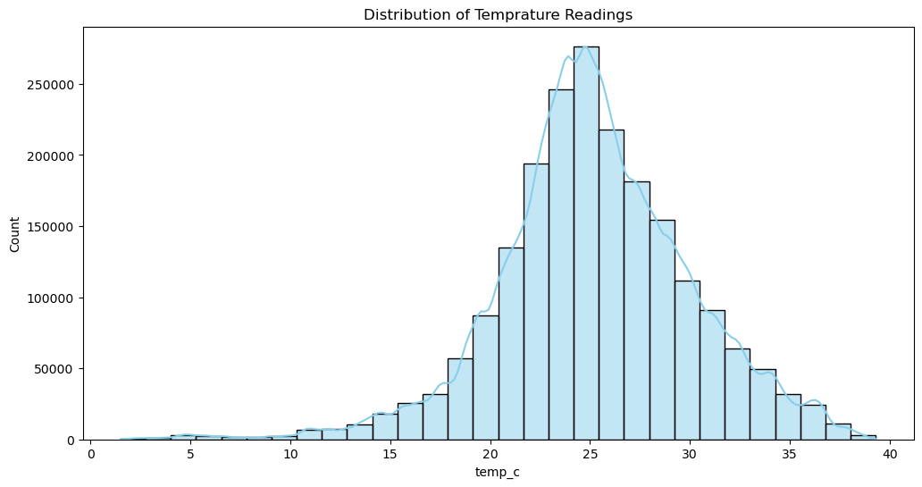
Conclusion : The temperature readings in the dataset are around an average of about 25^C. Most of the recorded temperatures fall between 22.5^C and 28.1^C. While most readings are within this comfortable, warm range, the dataset also includes some much colder temperatures, with the minimum reading being 1.5^C.

Slide 3
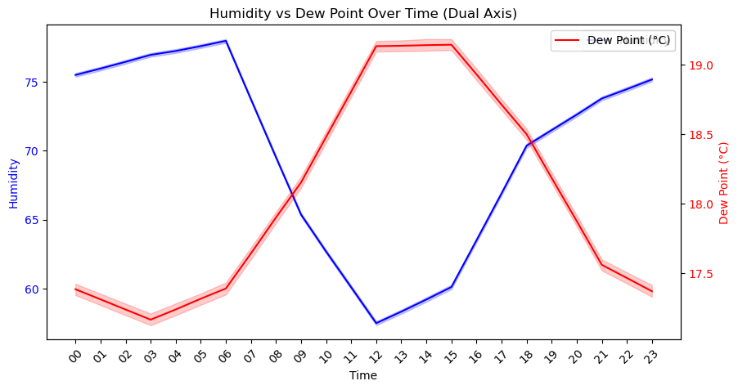
Conclusion :
From the graph, we can see that humidity and dew point move in a similar pattern over time.
When the dew point increases, the humidity also increases, and when the dew point decreases, the humidity drops.
This means there is a positive relationship between humidity and dew point.

Slide 4
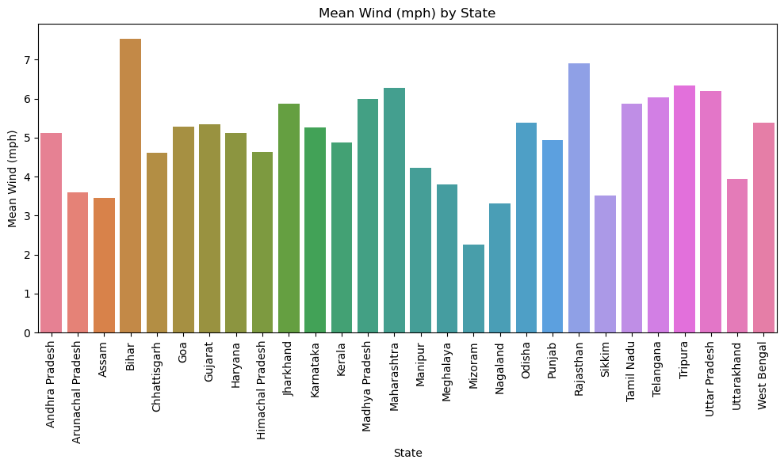
Conclusion :
Wind speeds vary significantly between states, and it is easier to identify which states experience higher average wind conditions.

Slide 5
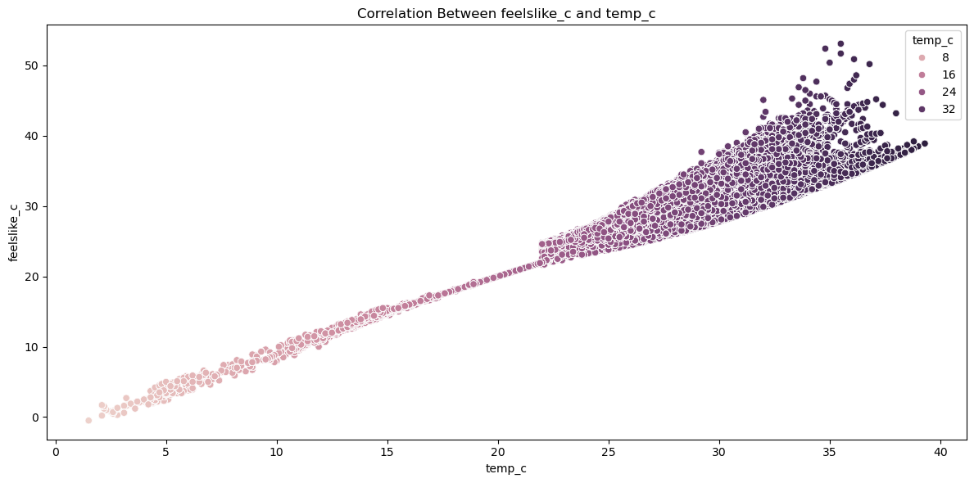
Conclusion:
There is a strong positive correlation between actual temperature (temp_c) and feels-like temperature (feelslike_c).
This means that when the actual temperature increases, the feels-like temperature also increases.
The points on the scatterplot would be closely clustered along a straight line, confirming that the “feels-like” temperature closely follows the actual temperature.

Slide 6
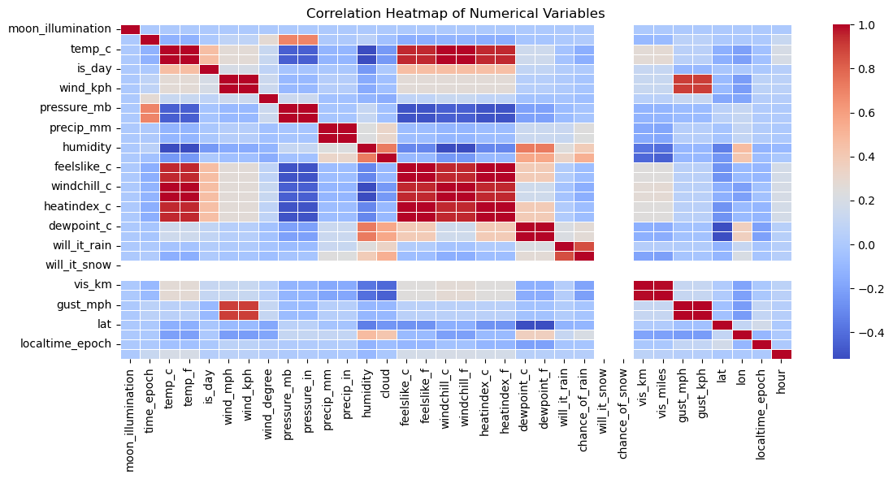
Conclusion :
Positive values (closer to +1) show strong positive correlation,* negative values (closer to −1) show strong negative correlation, and * values near 0 indicate weak or no relationship.* Darker or stronger colors show higher correlation, while lighter colors indicate weaker relationships.* From the heatmap, we can observe that: * Some weather variables show clear patterns, such as wind, gust, temperature, and humidity having noticeable color gradients. * Other variables show very weak or almost no correlation, as indicated by very light shades. * Overall, the heatmap provides a quick visual understanding of which numerical features move together and which behave independently.

Slide 7
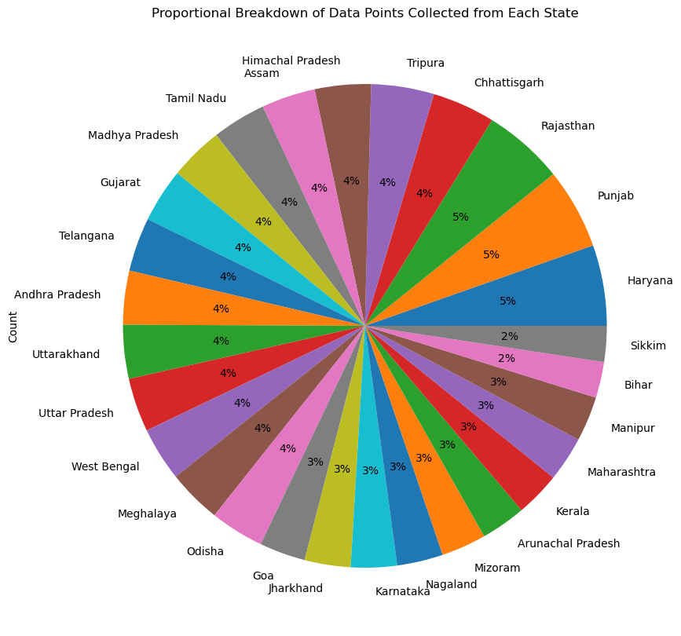
Conclusion :
The pie chart shows the percentage of total weather readings recorded from each state.
It helps identify which state contributes the highest number of data points and how the rest compare proportionally.

Slide 8
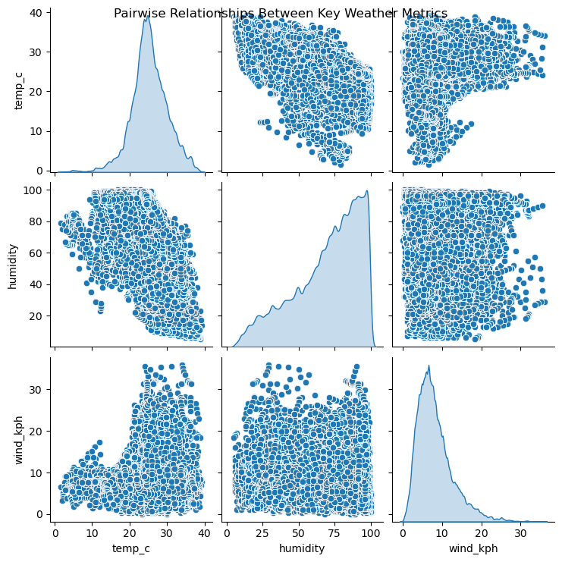
Conclusion :
There is no strong correlation between temperature, humidity, and wind speed.
Each variable changes independently:
Temperature and humidity do not move together strongly.
Wind speed shows almost no relationship with either temperature or humidity.
The pairplot shows scattered points, meaning the connections between these weather elements are weak.

Slide 9
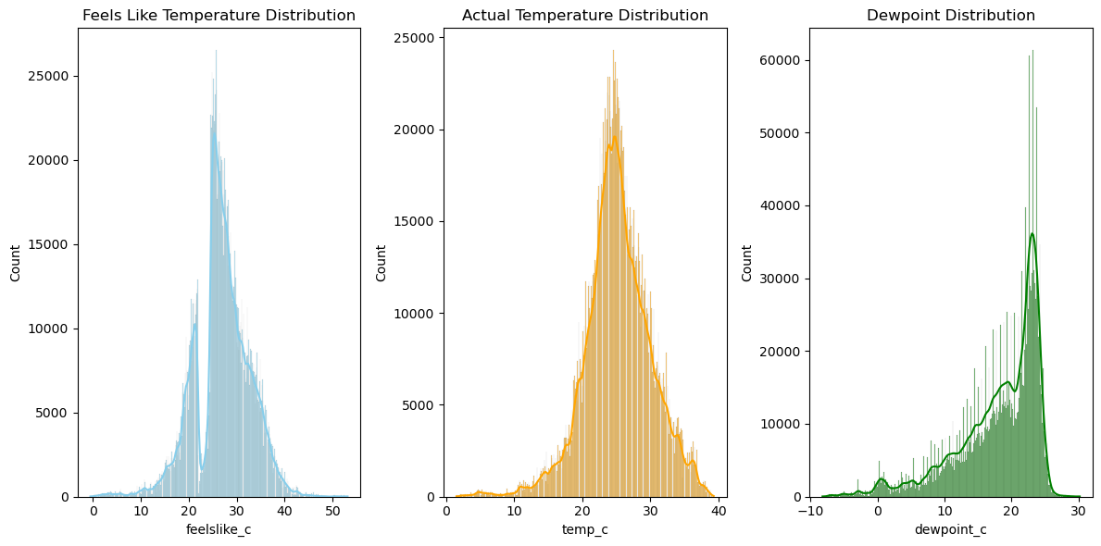
Conclusion :
1.Feels Like Temperature (feelslike_c)* Most values are closely clustered around the actual temperature.* Distribution is fairly symmetric, indicating typical daily temperature ranges.
2.Actual Temperature (temp_c)* Distribution is very similar to feelslike_c because perceived temperature depends largely on actual temperature.* Peaks indicate the most common temperature range in the dataset.
3.Dewpoint (dewpoint_c)* Slightly narrower distribution than temperature, showing less variation.* Higher dewpoints indicate more humid conditions; lower dewpoints indicate drier air.

Slide 10
Thank You

